Slide 1

Note: The data and information in this document is reflective of a hypothetical situation and client. This document is to be used for KPMG Virtual Internship purposes only.
Sprocket Central Pty Ltd
Data analytics approach
[A Niveditha]

Slide 2
Note: The data and information in this document is reflective of a hypothetical situation and client. This document is to be used for KPMG Virtual Internship purposes only.
Agenda
Introduction
Data Exploration
Model Development
Interpretation

Slide 3
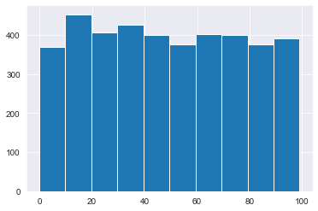
Note: The data and information in this document is reflective of a hypothetical situation and client. This document is to be used for KPMG Virtual Internship purposes only.
Introduction
In this module, we are going to visualize data and try to understand it better
I am considering the following columns to understand the customer data better:
online_order
standard_cost
owns_car
past_3_years_bike_related_purchases
gender
The figure on right shows the distribution of
past_3_years_bike_related_purchases.
Place any supporting images, graphs, data or extra text here.

Slide 4
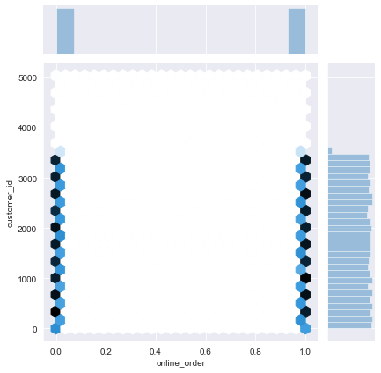
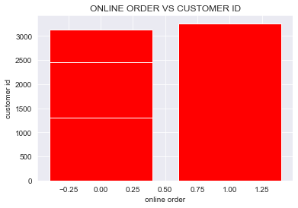
Data Exploration
Based on the transactions dataset we compare the number of new customers opting for online purchase
The figure in the right indicates that the number of customers opting for online purchase is more.
To be precise nearly 9829 customers opted for online purchase.
Place any supporting images, graphs, data or extra text here.

Slide 5
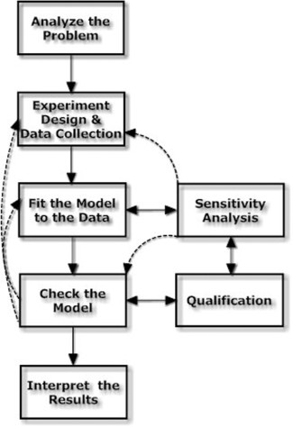
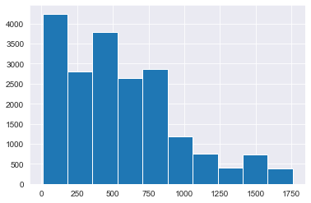
Note: The data and information in this document is reflective of a hypothetical situation and client. This document is to be used for KPMG Virtual Internship purposes only.
Model Development
Now we need to develop the appropriate model to select the model.
From the previous slide it was noted that the customers prefer online purchase and hence those customers must be targeted.
The figure below on right shows the distribution of price of purchased items.Although 0-250 range is higher, we can target 250-500 range as it will return higher profits.

Slide 6
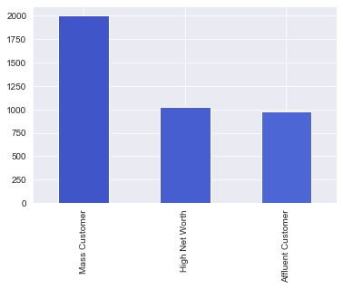
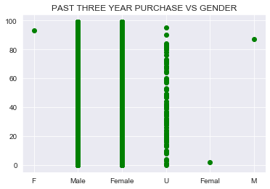
Note: The data and information in this document is reflective of a hypothetical situation and client. This document is to be used for KPMG Virtual Internship purposes only.
Interpretation
In this slide we interpret the data that we have analyzed so far.
In the given figure we can see that Mass Customer is greater count when it comes to wealth segment of the customer. So customers in mass Customer segment should be targeted.
Place any supporting images, graphs, data or extra text here.

Slide 7
Note: The data and information in this document is reflective of a hypothetical situation and client. This document is to be used for KPMG Virtual Internship purposes only.
Appendix

Slide 8
Note: The data and information in this document is reflective of a hypothetical situation and client. This document is to be used for KPMG Virtual Internship purposes only.
Appendix
This is an optional slide where you may place any supporting items.

